Slide 2
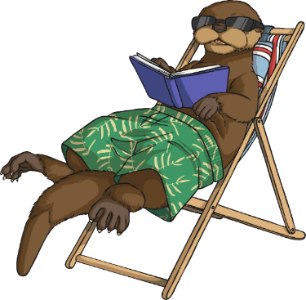
Year 6 Project Pack: Anywhere Island
During this project you will:
Develop your problem-solving and creative thinking skills.
Make decisions and choices.
Explore environmental threats and understand how to live more sustainable lives.
Use a range of geographical, scientific, mathematical and literacy skills.
Discuss your opinions on important issues.
Let your imagination run wild and have fun!

Slide 3
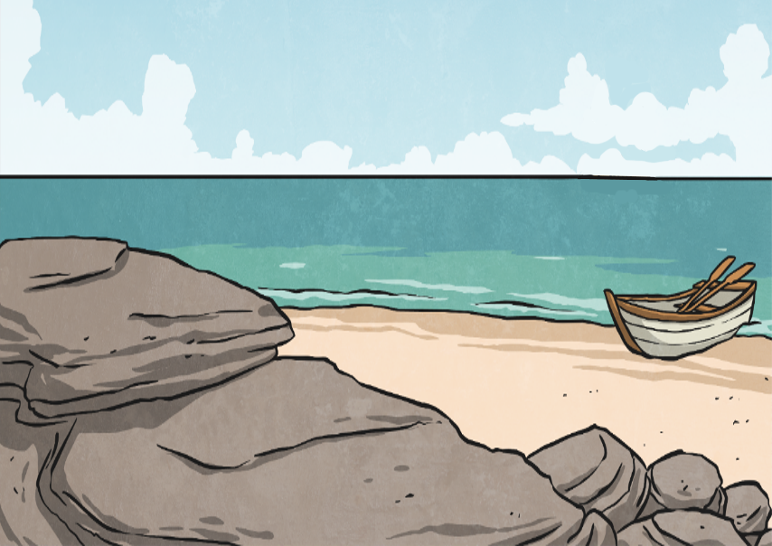
Lesson 1: The Discovery
You are part of an environmentalist expedition and have come across an uninhabited, previously undiscovered island. This island is the most beautiful, natural place you have seen and is home to many species of flora and fauna unknown to man.

Slide 4
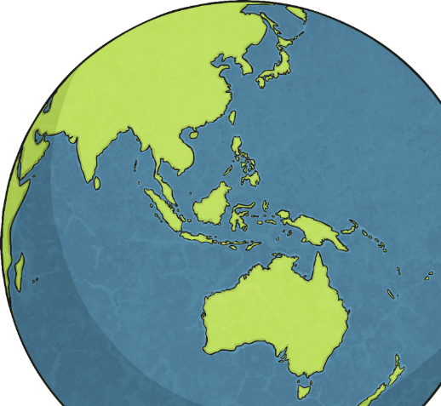
Where in the World Are You?
Use atlases, globes or interactive maps on the Internet to decide where you’d like your newly discovered island to be.
Which sea or ocean does the island lay in?
Is it in the northern or southern hemisphere?
Which continent is the island associated with?

Slide 5
X Marks the Spot!
Use ‘The Island Design Activity Sheet’ for these activities.
Mark an x on your world map to show where the island is to be located.
The Location of the Island
e.g.
The island lays just off the west coast of…
To the south of the island is the country of…
It is in the ________ ocean/sea.
Which countries and other islands are closest to it?
How close are they?

Slide 6
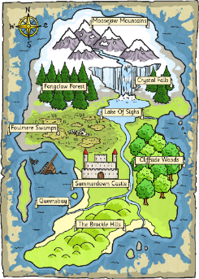
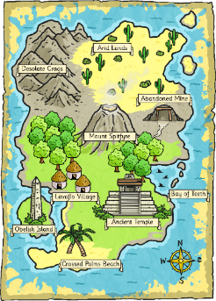
Designing the Island
Now is your chance to design the island.
What will it be called? What geographical features or landmarks will it have? As it is undiscovered, only natural landmarks will be there. What will you call these features?
Look at these maps for some inspiration…

Slide 7
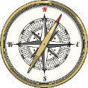
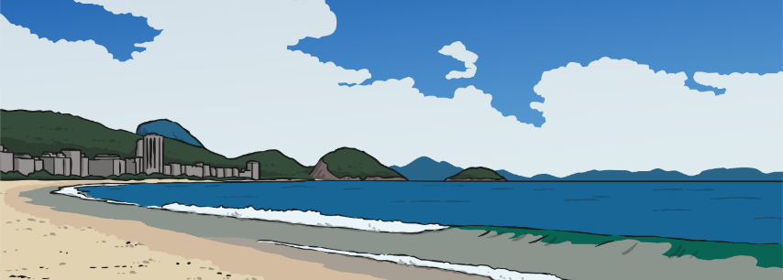
An Anywhere Island
Questions to think about
What geographical features or landmarks have you added to
the island?
What are the coordinates of a specific geographical feature or landmark?
What is your most southerly geographical feature or landmark?
Can you work out the total area of the island?

Slide 8
Lesson 2: First Impressions
You are approaching the newly discovered island for the first time.
Whereabouts on the island would your boat dock? Which coast is that on?
Close your eyes and imagine…

Slide 9
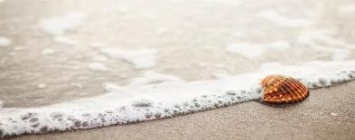
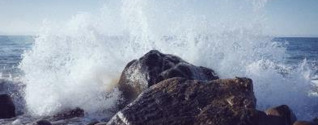
Use Your Senses
What can you see around you?
What can you smell?
What can you hear?
What can you feel – With your fingers? Under your feet? Against your cheeks?
Would you feel…
A sense of excitement? Nervousness? Accomplishment?

Slide 10
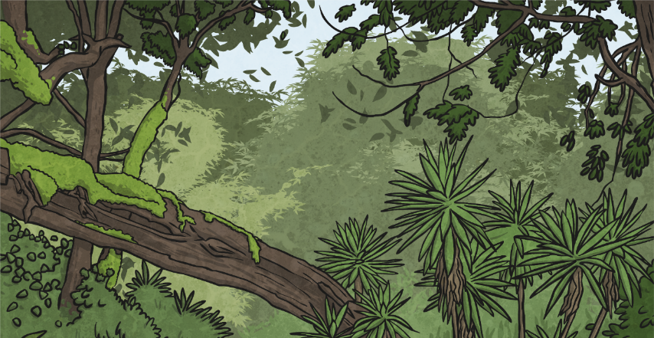
Collect Ambitious Vocabulary
Complete the ‘Use Your Senses Vocabulary Collection Sheet’ to write down all the words and phrases you can think of.
Use thesauruses and dictionaries to try and collect rich, ambitious vocabulary.

Slide 11
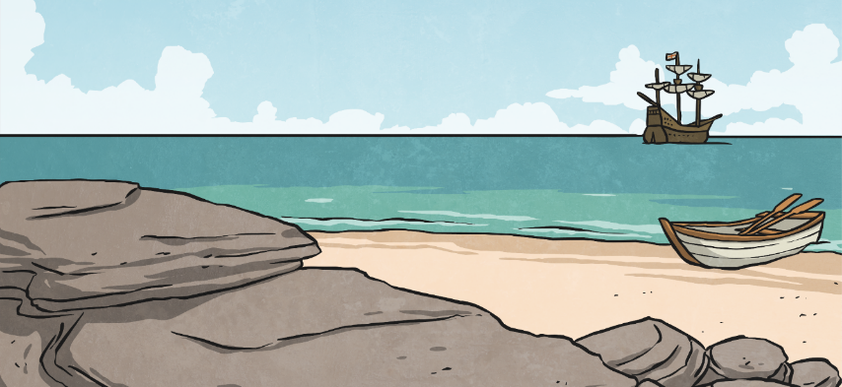
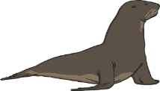
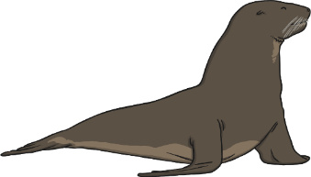
Use Your Ideas!
Now, turn your ideas into a passage of descriptive writing about your first impressions of the island.
How could you open your sentences?
Upon first glance,
Above my head,
Everywhere I looked,
With utter jubilation,
Mysteriously,
Under my feet,
As I came into dock,

Slide 12
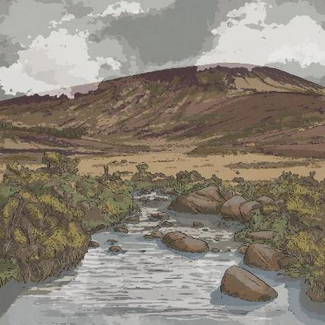
Lesson 3: Create the Identity for an Environmental Agency
The island has a wide range of flora and fauna, which are quite rare. The island needs protecting by an environmental agency.
In this lesson, you will design the identity of the environmental agency, including the name and logo.

Slide 13
The Environmental Agency Name and Logo
The name and logo of a company need to represent what they stand for and what they consider important. It lets people know what that company is about from just looking at the name and logo.
What sort of message would an environmental agency like to give people?
What do you think is important to them?
How might that look in a logo and the name?
What colours and images might be used on the logo?
Did You Know…?
A logo is a symbol that represents the identity of a company.

Slide 14
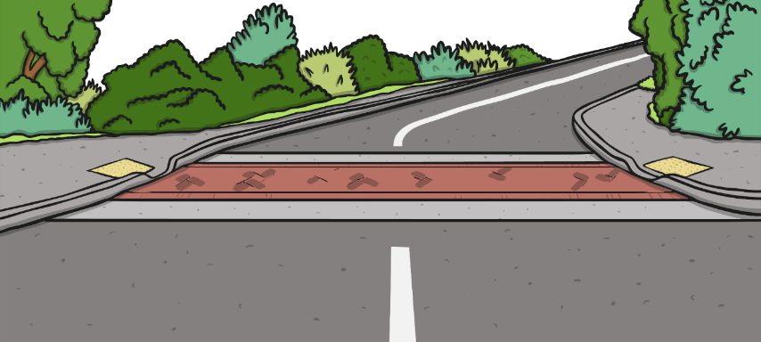
Lesson 4: The Island Rules
The environmental agency need to make sure that any visitors know what they can and can’t do on the island so that they can protect the natural beauty and any creatures that live there.

Slide 15
How Could Visitors Affect the Island?
This was a previously undiscovered island but now people know about it, how might visitors affect it?
Jot down some suggestions of how visitors might have an impact on the island. Then, think about what the environmental agency could do to continue to protect the ecology of the island.

Slide 16
Dos and Don’ts
What will visitors be allowed to do on the island?
Will they be able to go anywhere on the island?
Will they be able to bring food and drink?
What needs to be in place for this to happen?
Can they bring a dog?
Will camping be allowed? If so, how will it be organised?
What sort of things will visitors not be allowed to do?

Slide 17
Design a Poster
Use the ‘Design a Poster for Visitors Sheet’ to design a poster that gives details of the dos and don’ts for visitors.

Slide 18
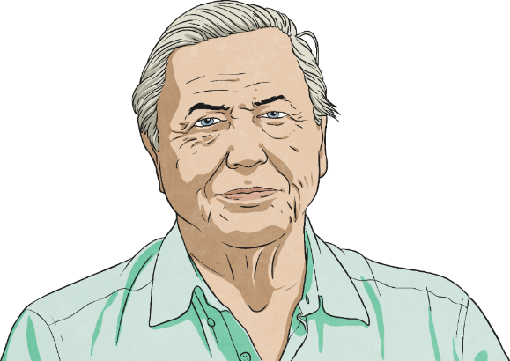
Lesson 5: Stop the Press!
David Attenborough and his film crew are on their way to the island because your team has found a new species of animal on the island.

Slide 19
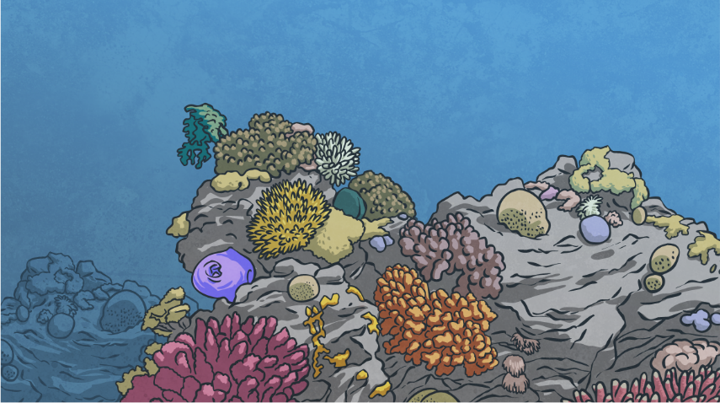
Animal Classification
What is it that has been found?
Is it a vertebrate or invertebrate? Can you remember what these terms mean?
How are vertebrates classified further?

Slide 20
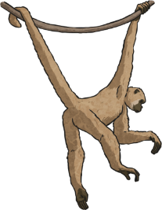
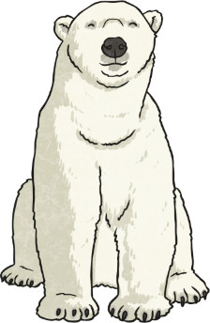
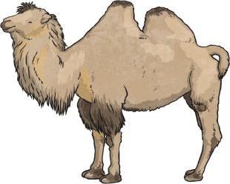
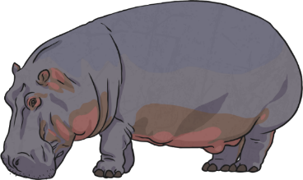
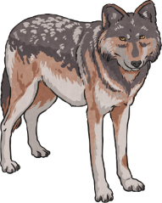
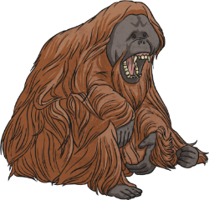
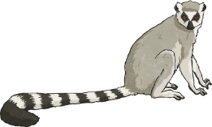
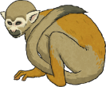
Weird and Wonderful Species
On the next few slides, we’ll look at some of the weirdest species of animals that have been found all over the world.
Do any of them have similar characteristics to the discovery on the island?

Slide 21
Weird and Wonderful Species
Pink Fairy Armadillo
The pink fairy armadillo is the smallest species of armadillo – a mammal with a bony shell armour. They are usually found in the sandy plains, dunes and grasslands of Argentina. The species have small eyes, silky yellowish white fur and a flexible shell that is solely attached to its body by a thin membrane. This unusual creature is nocturnal and has solitary habits, preferring to live alone. Its diet is mainly composed of insects, worms, snails and various plants.
“Washington DC--October 18 2007--Museum of Natural History--Pink Fairy Armadillo” by Makushine Pa’I Ki’I is licensed under CC BY 2.0

Slide 22
Weird and Wonderful Species
Axolotl
Axolotls are a type of amphibian salamander. They can only be found in Lake Xochimilco, near Mexico City. Unlike other amphibians, axolotls spend their entire life in the water. This unique-looking animal is listed as critically endangered. Their body can be black, mottled brown, albino (without any pigment) or white. Axolotls look like a tadpole with limbs, a fin and a pair of gills. Unusually, they do not have eyelids! They are carnivores (meat-eaters) and like to eat molluscs, crustaceans and small fish.

Slide 23
Weird and Wonderful Species
Tarsier
Tarsiers are a type of mammal primate. They have enormous eyes and long feet. Their feet have extremely elongated tarsus bones, which is how they got their name. They are insectivores and catch insects by jumping at them. They are mainly found in the forests of the Southeast Asian islands of the Philippines, Malaysia and Indonesia.
All tarsier species are nocturnal and they are extremely shy animals.

Slide 24
Weird and Wonderful Species
Kakapo
The kakapo is a nocturnal parrot that has evolved to be flightless due to the absence of predators in its New Zealand habitat. Due mainly to hunting, it is now almost extinct and survives only on some small, intensively managed islands. Dedicated conservation efforts have seen their population increase slowly to around 210 individual birds on the whole planet. The species are the heaviest parrot in the world and have a very long life expectancy – some have been known to live up to 90 years! The kakapo has a herbivorous diet, eating seeds, nuts, fruits, berries and flowers.
“kakapo chick” by Department of Conservation is licensed under CC BY 2.0

Slide 25
Weird and Wonderful Species
Blobfish
Blobfish get their name from their soft, fleshy body, which lacks muscle or much of a skeleton. This makes them very floppy when they are taken out of water. They live at such deep depths in the waters off the coasts of Australia and New Zealand (up to 600 and 1200 metres below the water surface), that they don’t have the normal swim bladder that most fish use to move up and down. If they did, the swim bladder would explode because of the extreme water pressure their bodies incur. Blobfish have very large mouths that they use to catch crustaceans, as well as any other edible matter, as they swim slowly along the floor of the ocean.
“Blob fish” by Claf Hong is licensed under CC BY 2.0

Slide 26
Design Your New Species
Create your new species that has been discovered on the island.
Questions:
Which animal group does it belong to?
What does its diet consist of?
What are its predators?
What is its natural habitat?
What makes it unique?
What does it look like?
What will you name it?

Slide 27
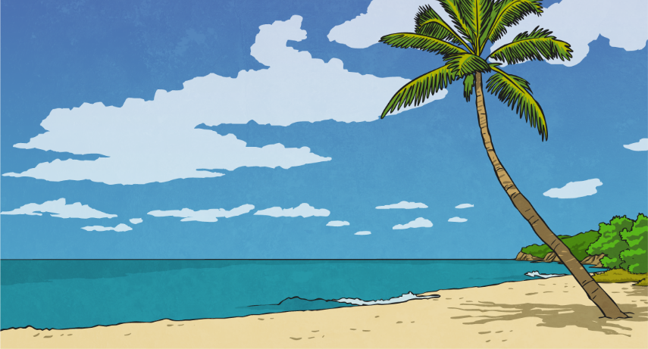
Lesson 6: Developing a Tourism Industry
Now that you have discovered the beauty and uniqueness of the island, you want to be able to share it with others and develop a way of accommodating visitors while sustaining the island’s ecology.
Questions:
Why would visitors want to visit the island?
What unique features does it have?
What sights could they see?
What activities could they participate in?

Slide 28
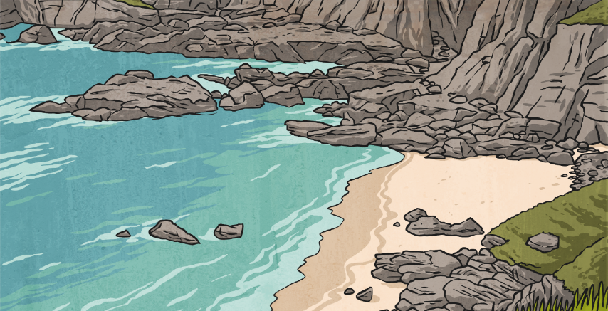
Persuasive Holiday Brochure
Your final job is to create a persuasive holiday brochure to encourage visitors to the island, while making sure they are aware of the need to protect the wildlife.
What features and persuasive devices can you find in the tourist brochures on your desk?
.

Slide 29
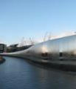
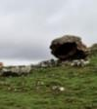
What a Successful Brochure Looks Like
What features can you spot in this travel brochure?
beautiful images
Summer in Yorkshire
It’s Cycling Heaven
rhetorical questions
exciting/emotive language
Are you mad about cycling and looking for something different this summer?
Come to Yorkshire this summer for Le Tour Yorkshire and you will also get beautiful beaches, wild wilderness, magnificent history and stunning cities.
personal pronouns
flattering descriptions
York, Leeds and Sheffield
If you love city life, come and stay in one of these great cities and soak up the atmosphere of Le Tour! There are museums, minsters and lots of great shops.
informal language
present tense
repetition
Wild Wilderness
As Le Tour winds its way up through the stunning Yorkshire moorlands, you can camp under the stars at one of the peaceful campsites along the route.
clear presentation

